Slide 1
CLEANROOM SOFTWARE ENGINEERING

Slide 2
Overview
What is Cleanroom Software Engineering?
Brief History
The Processes
Cleanroom and Object Oriented Methods
Benefits
Project Statistics
Conclusion

Slide 3
What is Cleanroom Software Engineering?
Set of principles and practices for software management, specification, design, and testing.
  Improve quality
  Increase productivity
  Reduce cost
Emphasis on defect prevention rather than defect removal.

Slide 4
Focuses on engineering based practices that produce software that is correct.
  Mathematically sound design
  Certified by statistically–valid testing
Reduced cycle time
  Incremental development strategy.
  Avoidance of rework.

Slide 5
Brief History
Developed by Dr. Harlan Mills of IBM’s Federal Systems division.
First published in 1981.
  Didn’t become popular until 1986.
IBM and other organizations began using this process in 1987.

Slide 6
Has evolved to keep up with changing world of software.
  From top-down structured programming to include object-oriented design.
Users have adapted Cleanroom to coexist with various tools and other techniques.

Slide 7
The Processes
Comprised of four different processes:
  Management
  Specification
  Development
  Certification
A separate team is required for each of these processes to ensure the highest quality product .

Slide 8
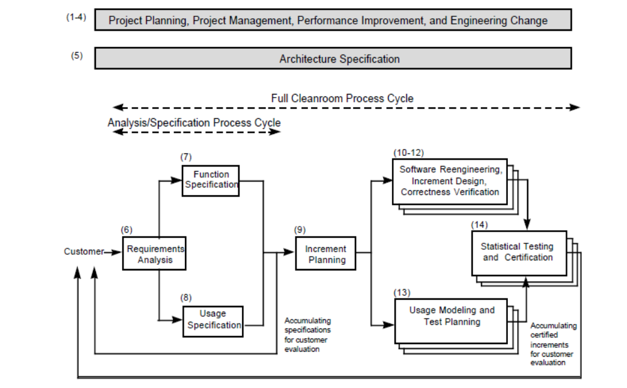
Process Lifecycle

Slide 9
The Cleanroom Process
Key:
Processes
Work Products
Specification
Function Usage
Customer Requirements
Functional Specification
Usage Specification
Incremental Development Planning
Incremental Development Plan
Box Structure Spec. and Design
Correctness Verification
Usage Modeling
Test Case Generation
Source Code
Test Cases
Statistical Testing
Failure Data
Improvement Feedback
Measures of
Operational Performance
Quality Certification Model
[Adapted from”Cleanroom Process Model,” Richard Linger, IEEE Software, March 1994]

Slide 10
The Cleanroom Process
Customer
Requirements
Requirements Spec
Usage Spec
Incremental
Development Plan
Incremental Design
Documentation
Test Case Generation
Correctness Verification
No
Correct?
Yes
Statistical Testing
Certification Model
No
Certified?
Yes
Incremental
Certified System
[Adapted from “Integrated CASE for Cleanroom Development,” Hevner, et al., IEEE Software, March 1992]

Slide 11
Management Process
The very first process in a Cleanroom Software Engineering project.
It is persistent throughout the whole project lifetime.
The Specification, Development, and Certification processes are placed on top of and use this process.

Slide 12
Project Planning
Cleanroom processes are tailored to meet project specific requirements
Document, define, and review the plans with the customer and project team.

Slide 13
Management Process specifies
  Project Mission
  Organization
  Work products
  Schedules
  Resources
  Measurements
  Reuse analysis
  Risk analysis
  Standards
  Training
  Configuration management.

Slide 14
Performance Improvement
Continually evaluate and “streamline” Cleanroom processes.
Introduce new technologies and processes.
Pinpoint potential problems with the lifecycle processes.

Slide 15
Engineering Change
Plan and perform additions, changes, and corrections to the work product.
The status of the changes is continually updated throughout the process.
Similar to other development processes.

Slide 16
Specification Process
First process of each increment.
Consists of:
  Requirement Analysis
  Function Specification
  Usage Specification
  Increment Planning

Slide 17
Requirements Analysis
Define requirements for the product.
  Function, usage, environment, and performance.
Obtain an agreement with the customer on the requirements.
Opportunity to simplify the customer’s initial product concept.
May reveal requirements that the customer had not addressed.

Slide 18
Function Specification
Specifies complete functional behavior of the software.
Expresses the requirements in a mathematically precise, complete, and consistent form.
An incremental specification strategy may be necessary for larger systems.

Slide 19
Usage Specification
Identifies and classifies software users, usage scenarios, and environment.
Establish and analyze high level structure and distribution for software models.
A good understanding of usage models is helpful for prioritizing the development activities.

Slide 20
Increment Planning
Allocate customer requirements into a series of software increments.
Define the schedule and resource allocations.
Increment Construction Plan
  Used by management to assign tasks, track progress, and monitor product quality and process control.

Slide 21
Development Process
Second process of each increment.
Comprised of:
  Software Reengineering
  Incremental Design
  Correctness Verification

Slide 22
Software Reengineering
Prepare reused software for incorporation into the software product.
  Can be mined from Cleanroom or non-Cleanroom environments.
Must meet two requirements
  Semantics and interface must be understood and documented.
  Must know why you’re going to reuse it.

Slide 23
Incremental Design
Design/implement software increment that satisfies the Increment Construction Plan, Function Specification, and Software Architecture.
  Box structure decomposition
Prohibited from executing the increment implementation.

Slide 24
Correctness Verification
Verifies the correctness of the software increment using mathematically based techniques.
Last line of defense against failures.
Transition to the testing phase with no faults in the design.
It is then turned over to the certification team for the first execution of the code.

Slide 25
Certification Process
Third and final process of each increment.
Comprised of:
  Usage Modeling and Test Planning
  Statistical Testing and Certification process

Slide 26
Usage Modeling and Test Planning
Refine the Usage Specification to create models for software testing and define test plans.
Certification team creates Usage Model, Increment Test Plan, and Statistical Test Cases.
  Developed incrementally.
The customer reviews the usage model and generates all scenarios of use.

Slide 27
Statistical Testing and Certification
Demonstrate the software’s performance.
Certification goals are established.
  Goals can be expressed in terms of software reliability, growth rate, and coverage.
Software undergoes first execution.
Success is determined by comparing software behavior with the Function Specification.

Slide 28
Determine whether or not to continue testing, to stop testing for changes to the software, or to continue on to final software certification.
  Depends on the outcome of the tests and how the software behaves compared to the Function Specification.

Slide 29
Cleanroom and Object Oriented
A study found that combining OO methodology with Cleanroom processes is capable of producing results that are reusable, predictable, and of high-quality.
OO can be used for domain analysis and problem decomposition. Cleanroom can be used for life-cycle processes.
Cleanroom focuses on correctness and techniques supporting verification.

Slide 30
OO focuses on design quality, maintainability, extendibility, and reusability.
Combination of these two techniques offers a high-quality product that is well decomposed and based upon good design principals.

Slide 31
Benefits
Delivers a high quality product that is verified as being correct.
Errors are found early on in the project
  Due to majority of project time spent in the design phase.
Leads to lower overall costs and reduces time spent finding errors.
  Reduces the overall project time

Slide 32
Few Examples

Slide 33
NASA satellite-control project
  Cost of training the team was calculated at 4% of project hours.
  Time allocation:
    33% design
    18% coding
    27% testing
    22% meetings and other overhead.
  69% higher productivity, 45% error reduction rate, and 60-80% decrease in resources used

Slide 34
IBM COBOL Restructuring Tool
Took place in 1988
85,000 lines of programming code
Ten-fold reduction in total defects per thousand lines of code.
Five-fold improvement in developer productivity measured in lines of code per month.
Only seven errors found in the first three years, all of which were simple fixes.

Slide 35
IBM AOExpert/MVS™ system outage analyser
(107,000 lines of code)
This product combined knowledge-based techniques with systems software.
Despite its complexity, it achieved a more than ten-fold reduction in total errors per thousand lines of code found during testing, compared to similar projects.
At the same time it reported a three-fold improvement in productivity.
No operational errors were reported during beta testing.

Slide 36
Ericsson Telecom OS32 operating system
350,000 lines of C and PLEX code
This telecommunications switch operating system reported a rate of one failure per thousand lines of code in testing, a seventy percent improvement in development productivity, and a 100 percent improvement in testing productivity.

Slide 37
Conclusion
Cleanroom SE ensures high-quality software with certified-reliability.
Has evolved throughout the years and has been incorporated in many new software practices.
Few defects with the possibility for zero defects.
Saves time and resources.
  Costs Less!

Slide 38
References
Foreman, John. (1997). Cleanroom Software Engineering Retrieved March 27, 2006 from http://www.sei.cmu.edu/str/descriptions/cleanroom_body.html
Deck, Michael. (1994). Cleanroom Software Engineering: Quality Improvement and Cost Reduction. Retrieved on March 27, 2006 from http://www.cleansoft.com/cleansoft_library.html
Linger, Richard C., Trammell, Carmen J. (November 1996). Cleanroom Software Engineering: Reference Model, Version 1.0. Retrieved March 27, 2006 from http://www.sei.cmu.edu/pub/documents/96.reports/pdf/tr022.96.pdf
Cleanroom Software Engineering, Inc. (September 1995). An Introduction to Cleanroom Software Engineering for Managers. Retrieved on March 28, 2006 from http://www.cleansoft.com/cleansoft_library.html

